Slide 1


Immersive Quiz for Spanish Learners
By Austin Klum

Slide 2
Introduction
What is some context to this project?
Why this project?
What was designed?

Slide 3
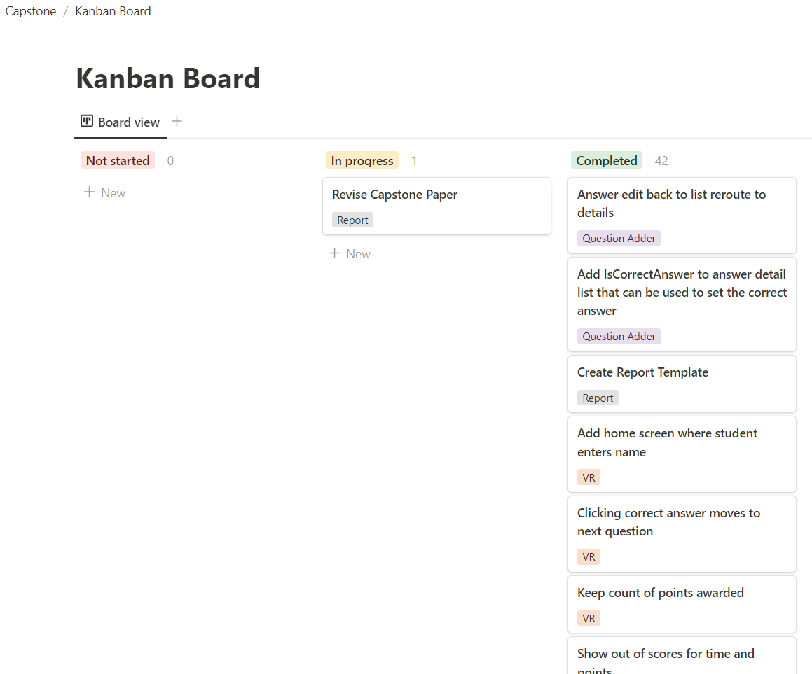
Requirements
Stakeholders
Iterative Agile Development Methodology
User, Verified User, and Student
Course Components
Locations
Questions
Answers

Slide 4
Requirements
Functional Requirements
Non-functional Requirements
Security Concerns

Slide 5
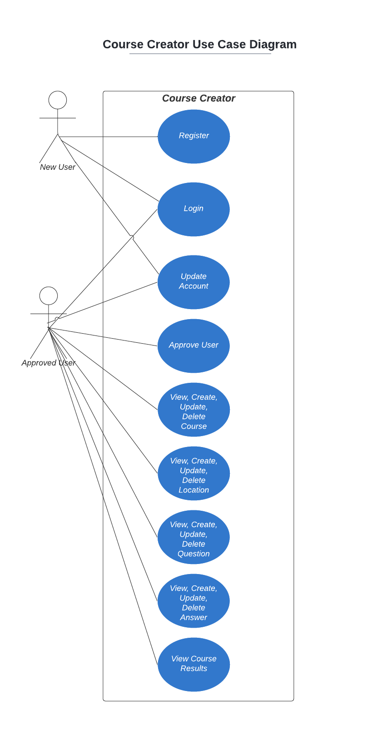
Course Creator Overview
What is the Course Creator?
How do users interact with the Course Creator?
What are the use cases?

Slide 6
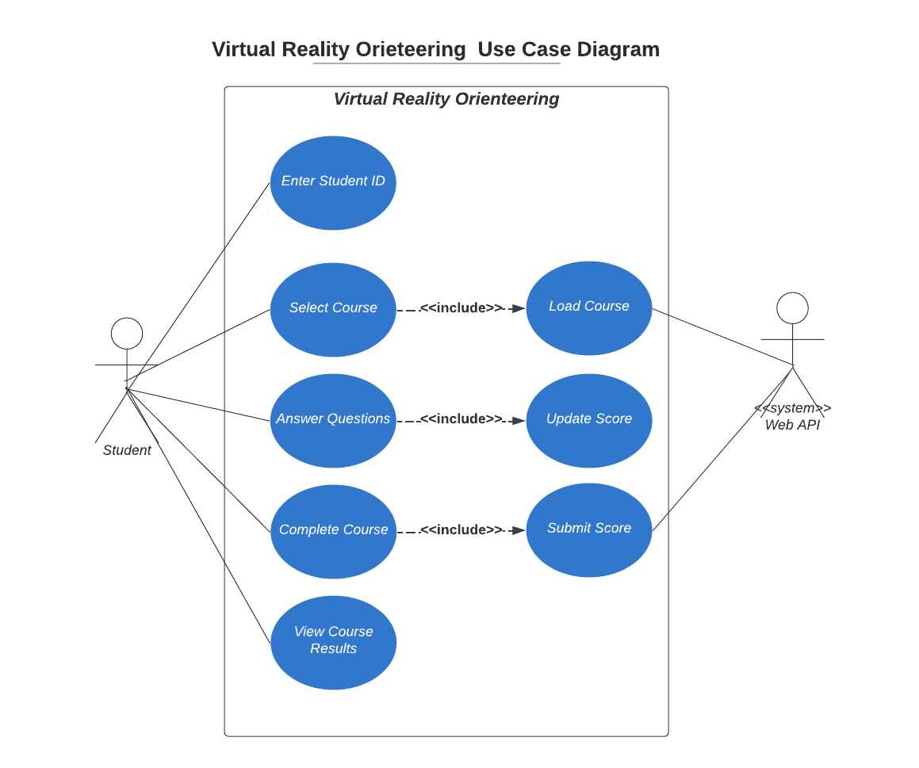
VR Orienteering Overview
What is the VR Orienteering Program?
How do users interact with the VR Orienteering Program?
What are the use cases?

Slide 7
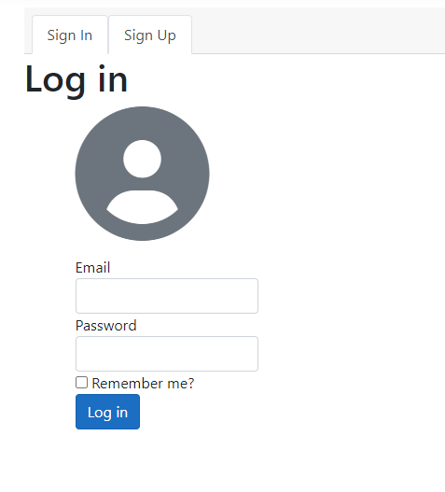
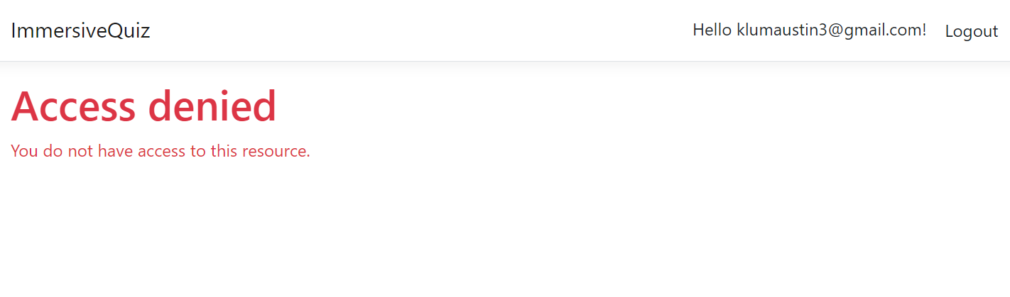
Course Creator – Access
User Registration
User Login

Slide 8
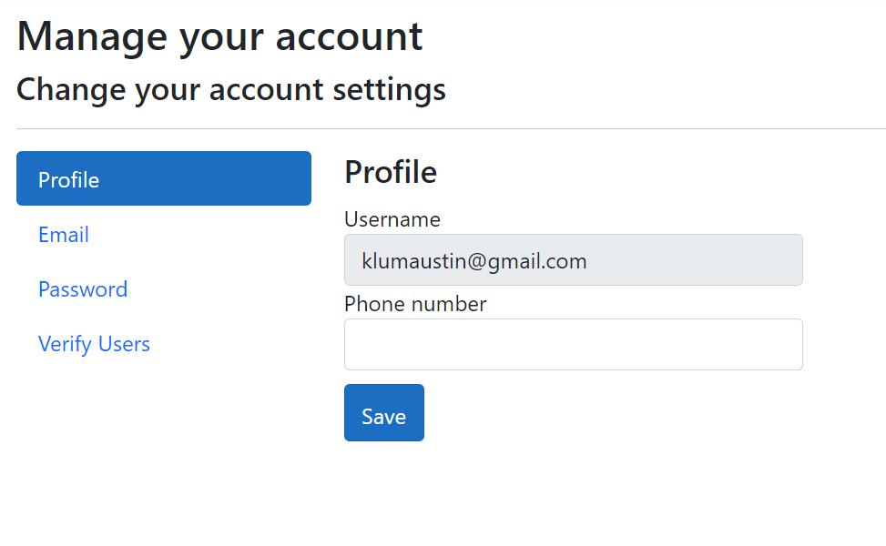
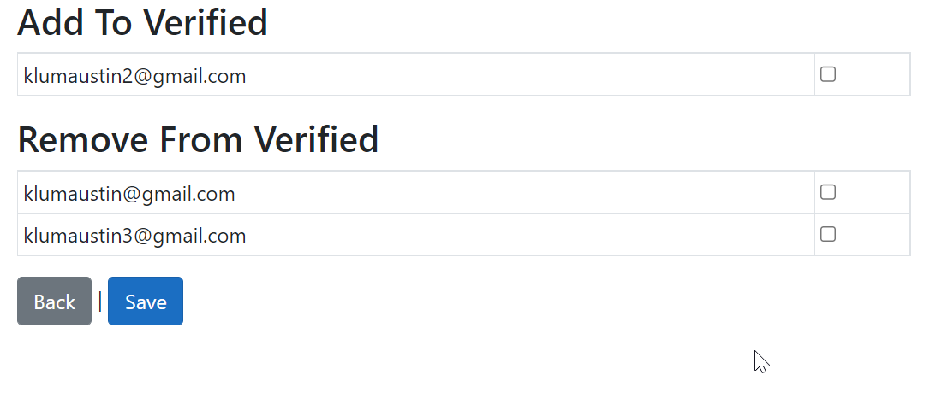
Course Creator - Modify Users
User Profile
Verify Users Page

Slide 9
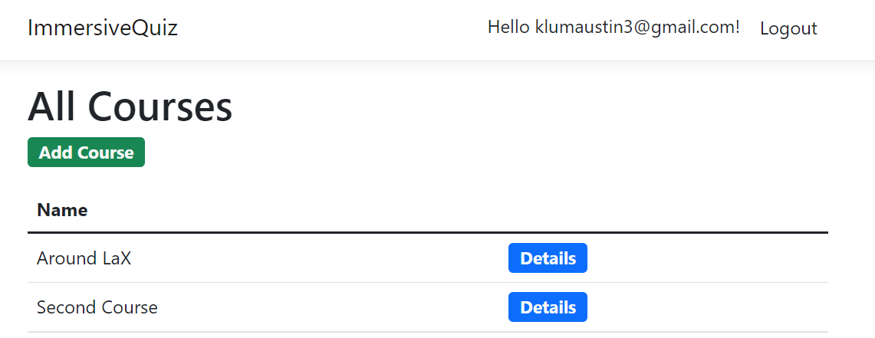
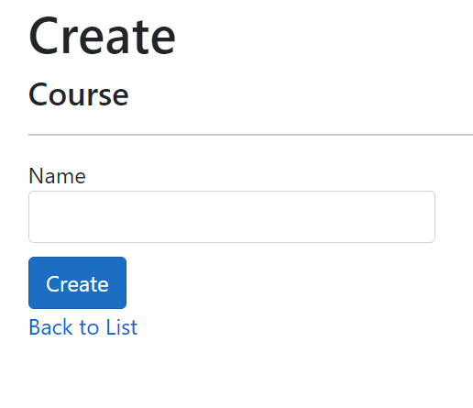
Course Creator - Start
View All Courses
Create Course

Slide 10
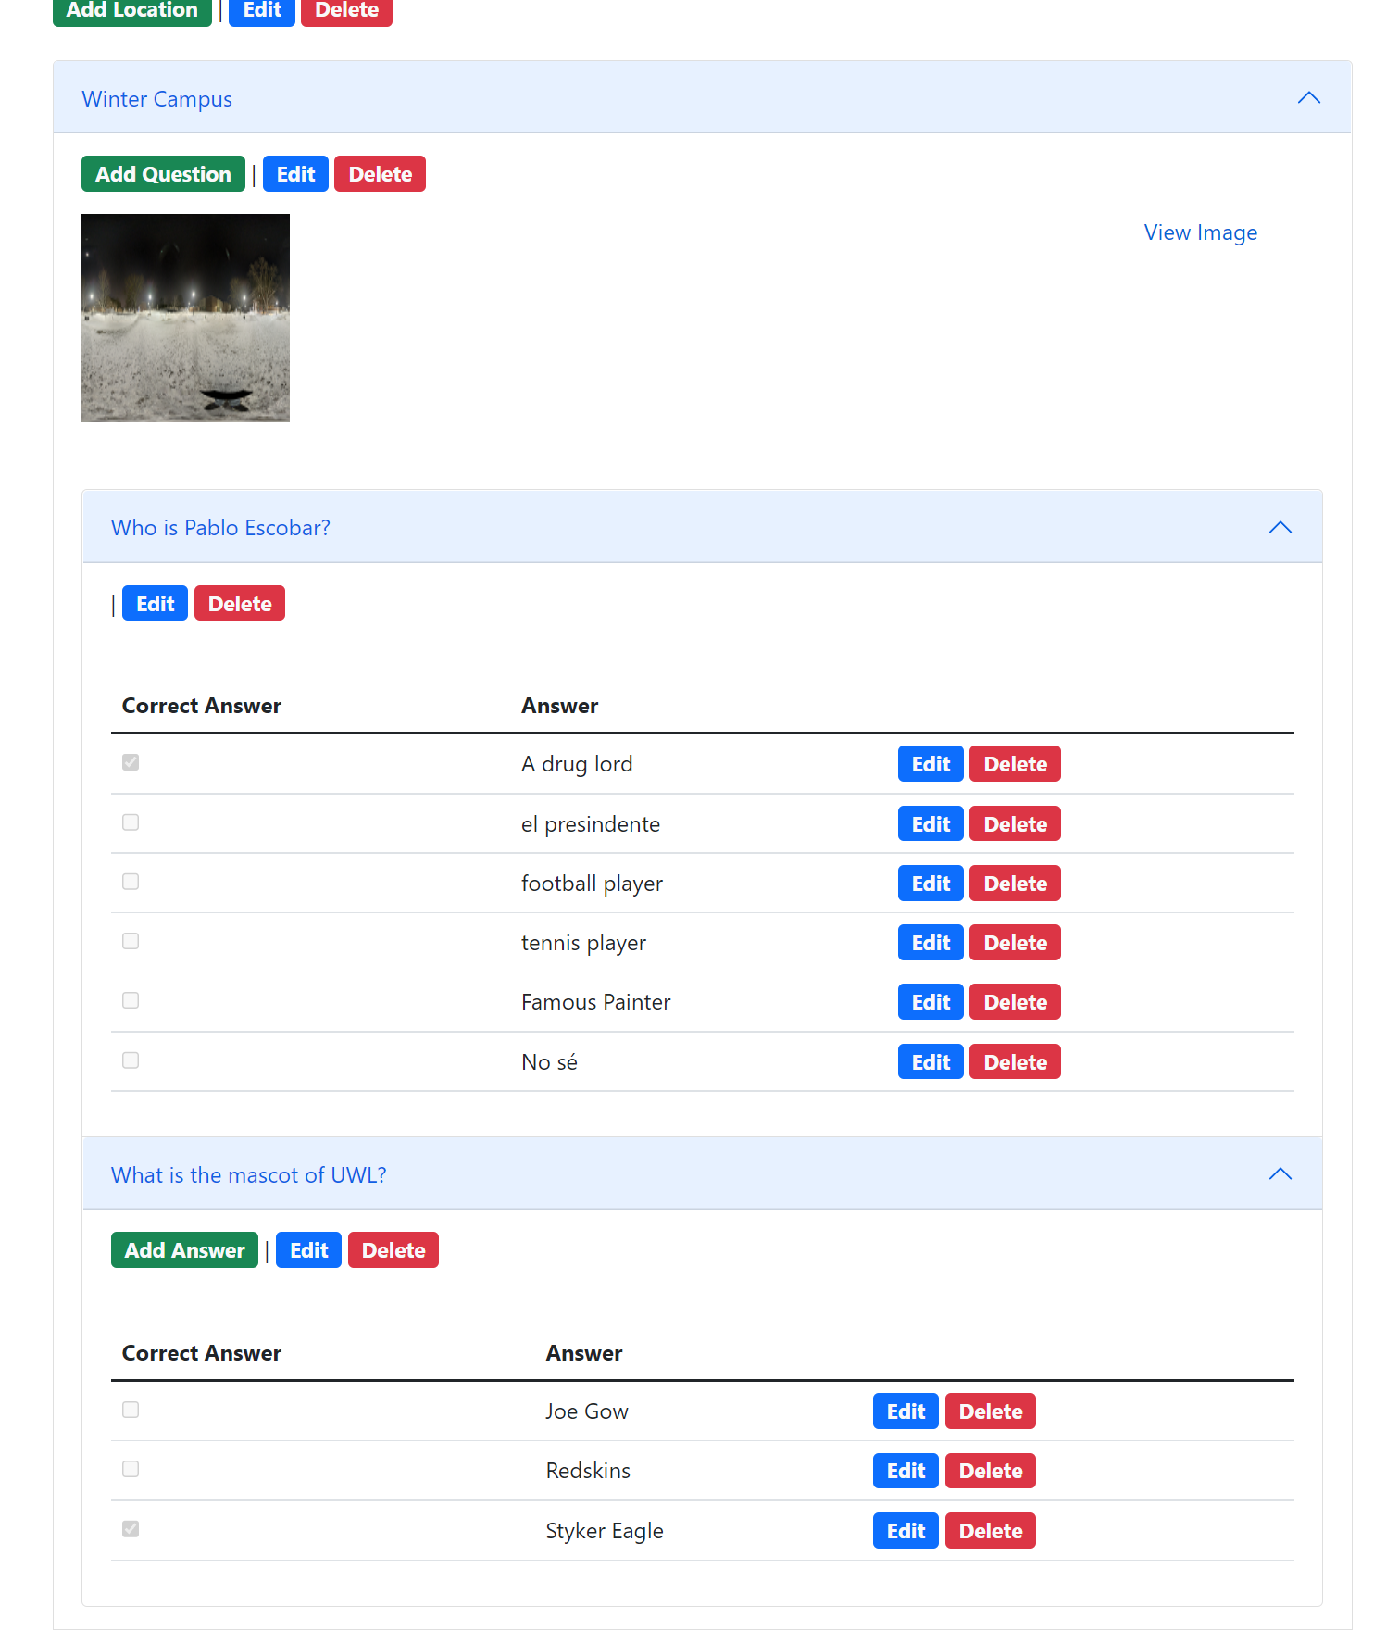
Course Creator – Detail View
Course Details
Location Details
Question Details
Answers Details

Slide 11
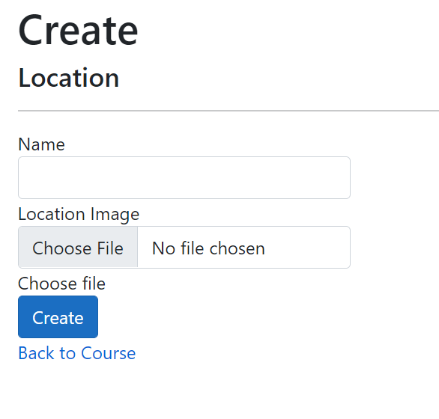
Course Creator – Create Component
Create Location

Slide 12
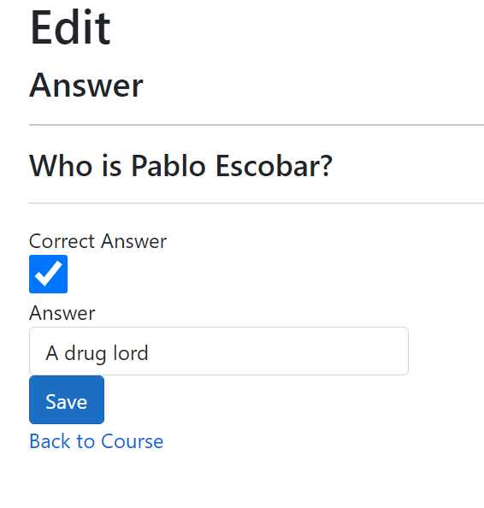
Course Creator – Edit Component
Edit Answer
Save
Back to Course

Slide 13
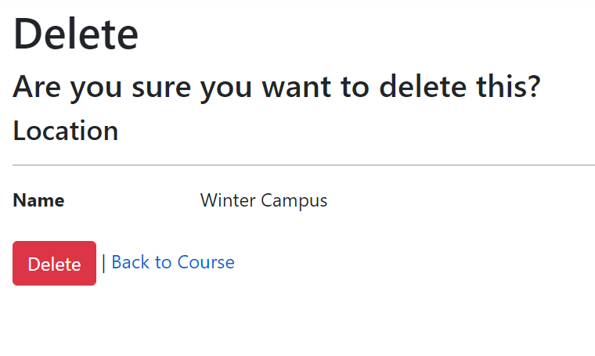
Course Creator – Delete Component
Delete Course
Delete
Back to Course List
Cascading Delete

Slide 14
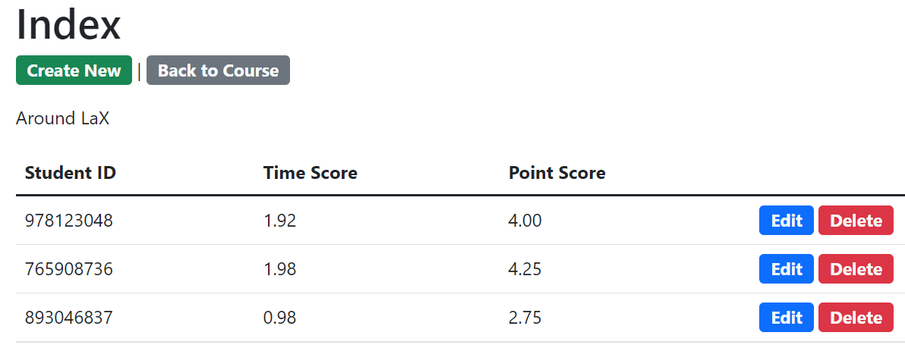
Course Creator - Scores
Scores by Course
Student ID
Time Score
Point Score
Create, Update, and Delete actions

Slide 15
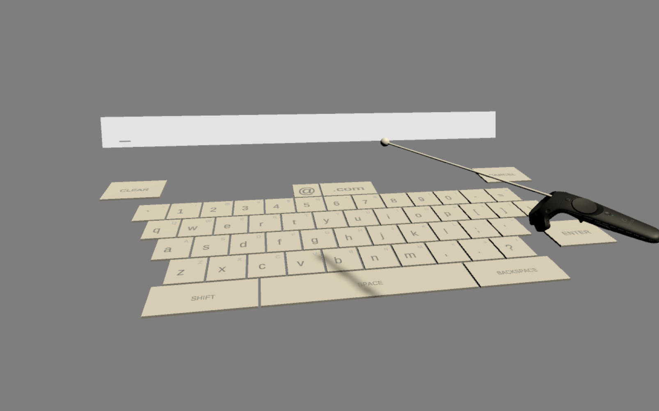
VR Orienteering - Access
VR Orienteering Program
VR headset
Enter Student ID
Select Course

Slide 16
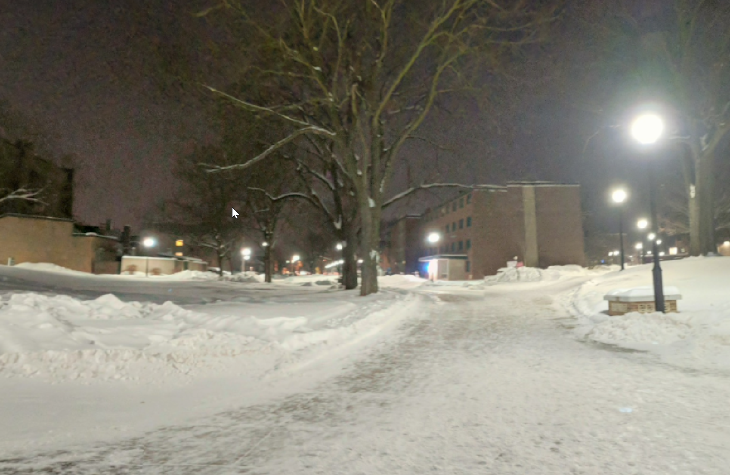
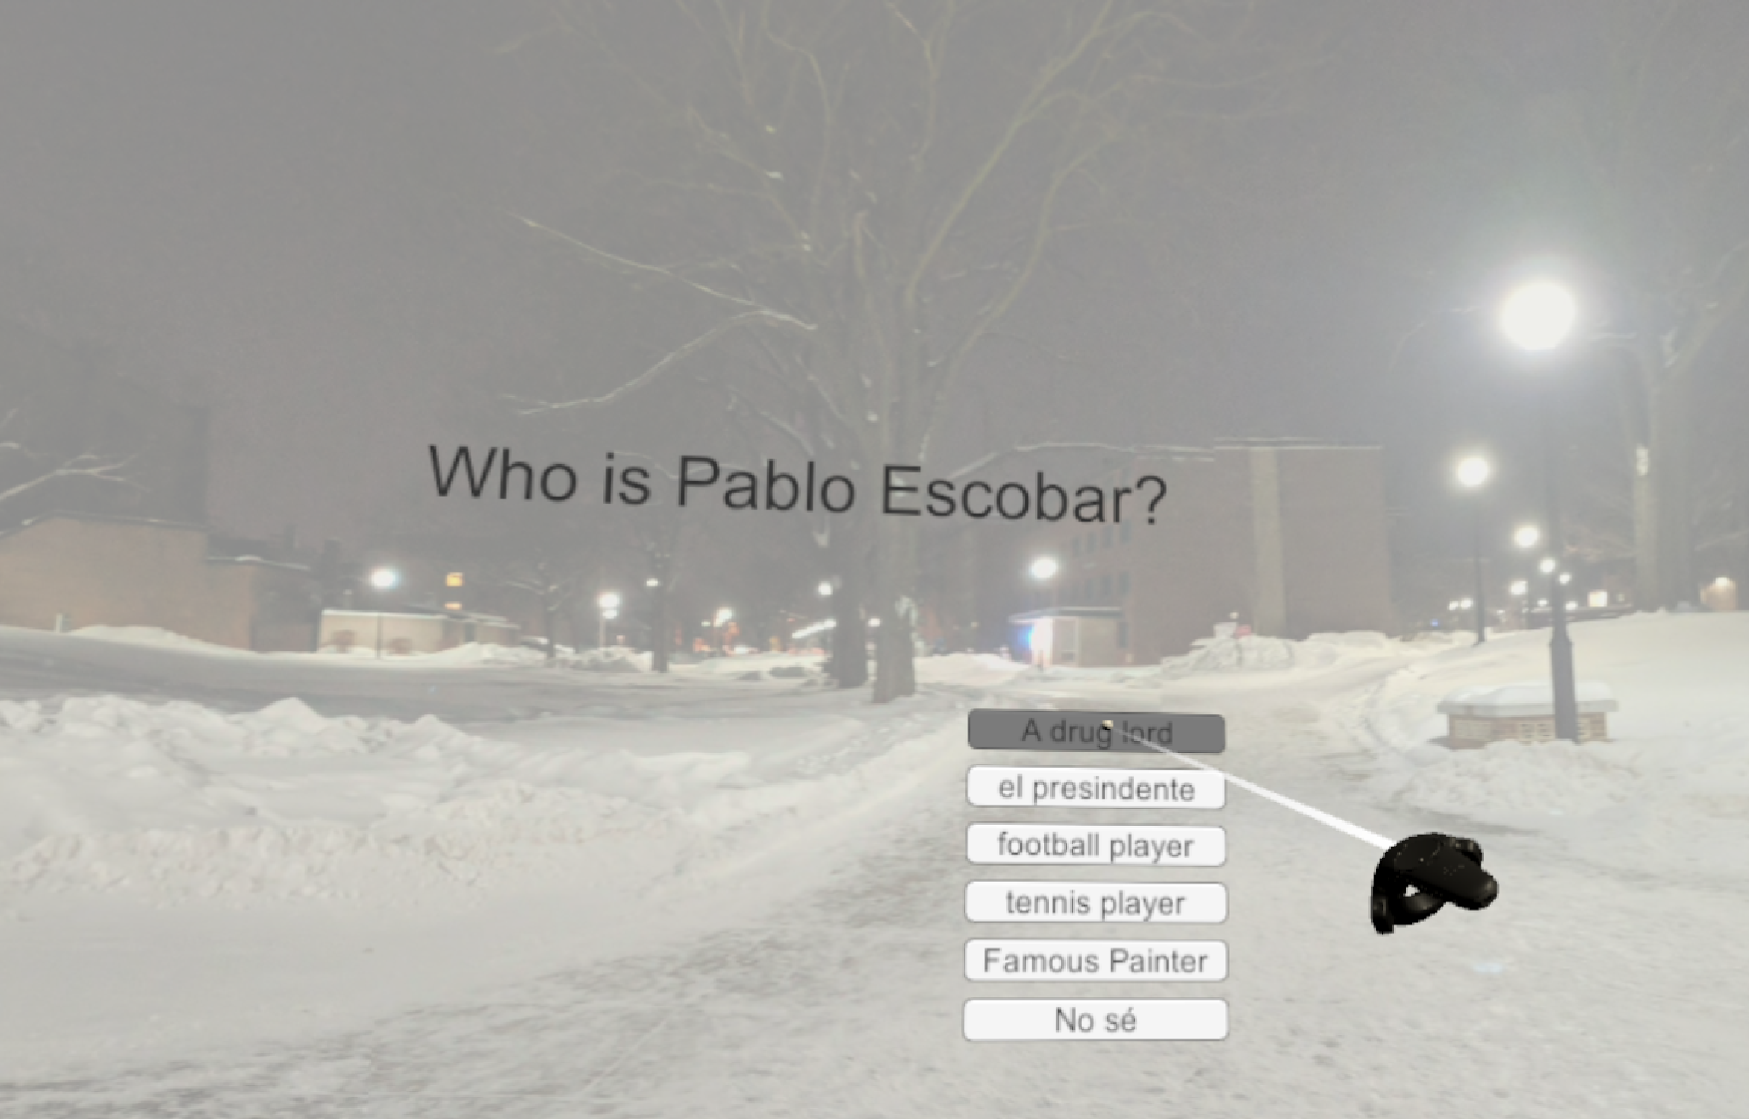
VR Orienteering – Navigating Course
Viewing Worldspace
Question Screen

Slide 17
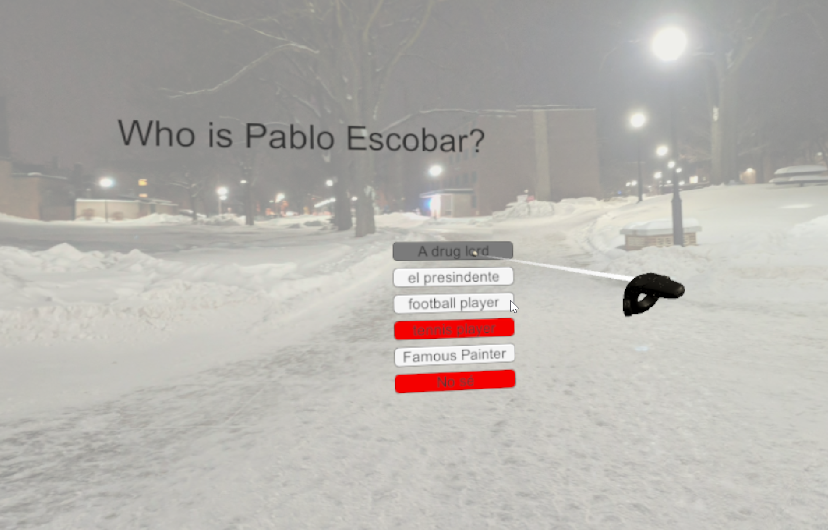
VR Orienteering – Answering Questions
Incorrect Answers
Scoring

Slide 18
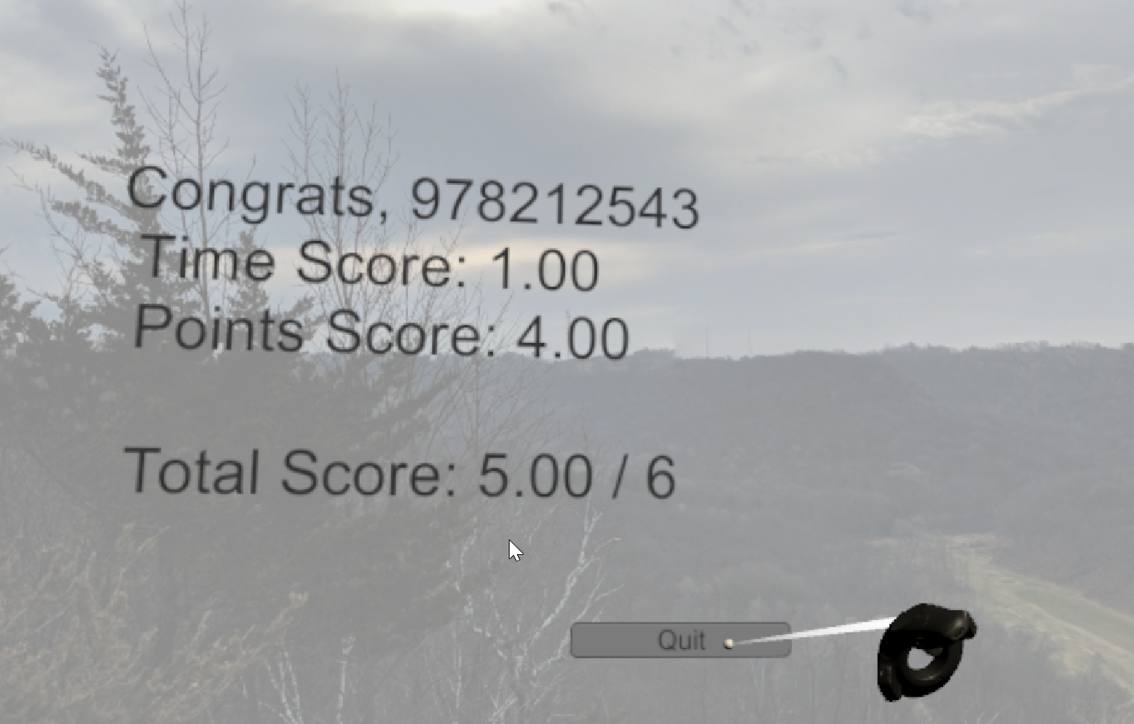
VR Orienteering – Finish Course
Game Over Screen
Score Submission
Quit Program

Slide 19
Technologies – Course Creator
ASP.NET Core MVC
URL Routing
Model Binding
Dependency Injection
Filters
Razor View Engine
Entity Framework Core
Bootstrap

Slide 20
Technologies – VR Orienteering
Unity
Unity XR Interaction Toolkit
OpenXR
GameObjects
Assets
Scenes

Slide 21
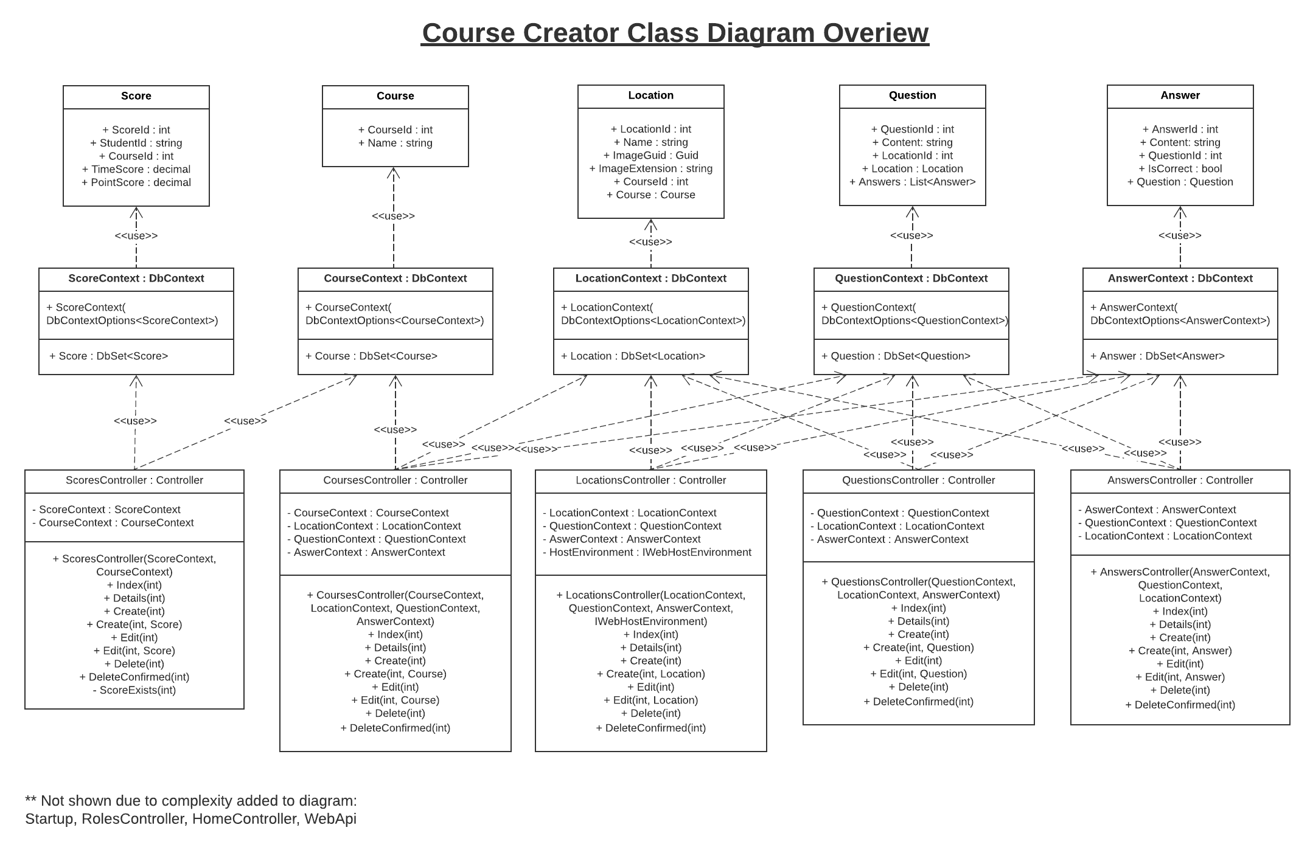
Class Diagram - Course Creator

Slide 22
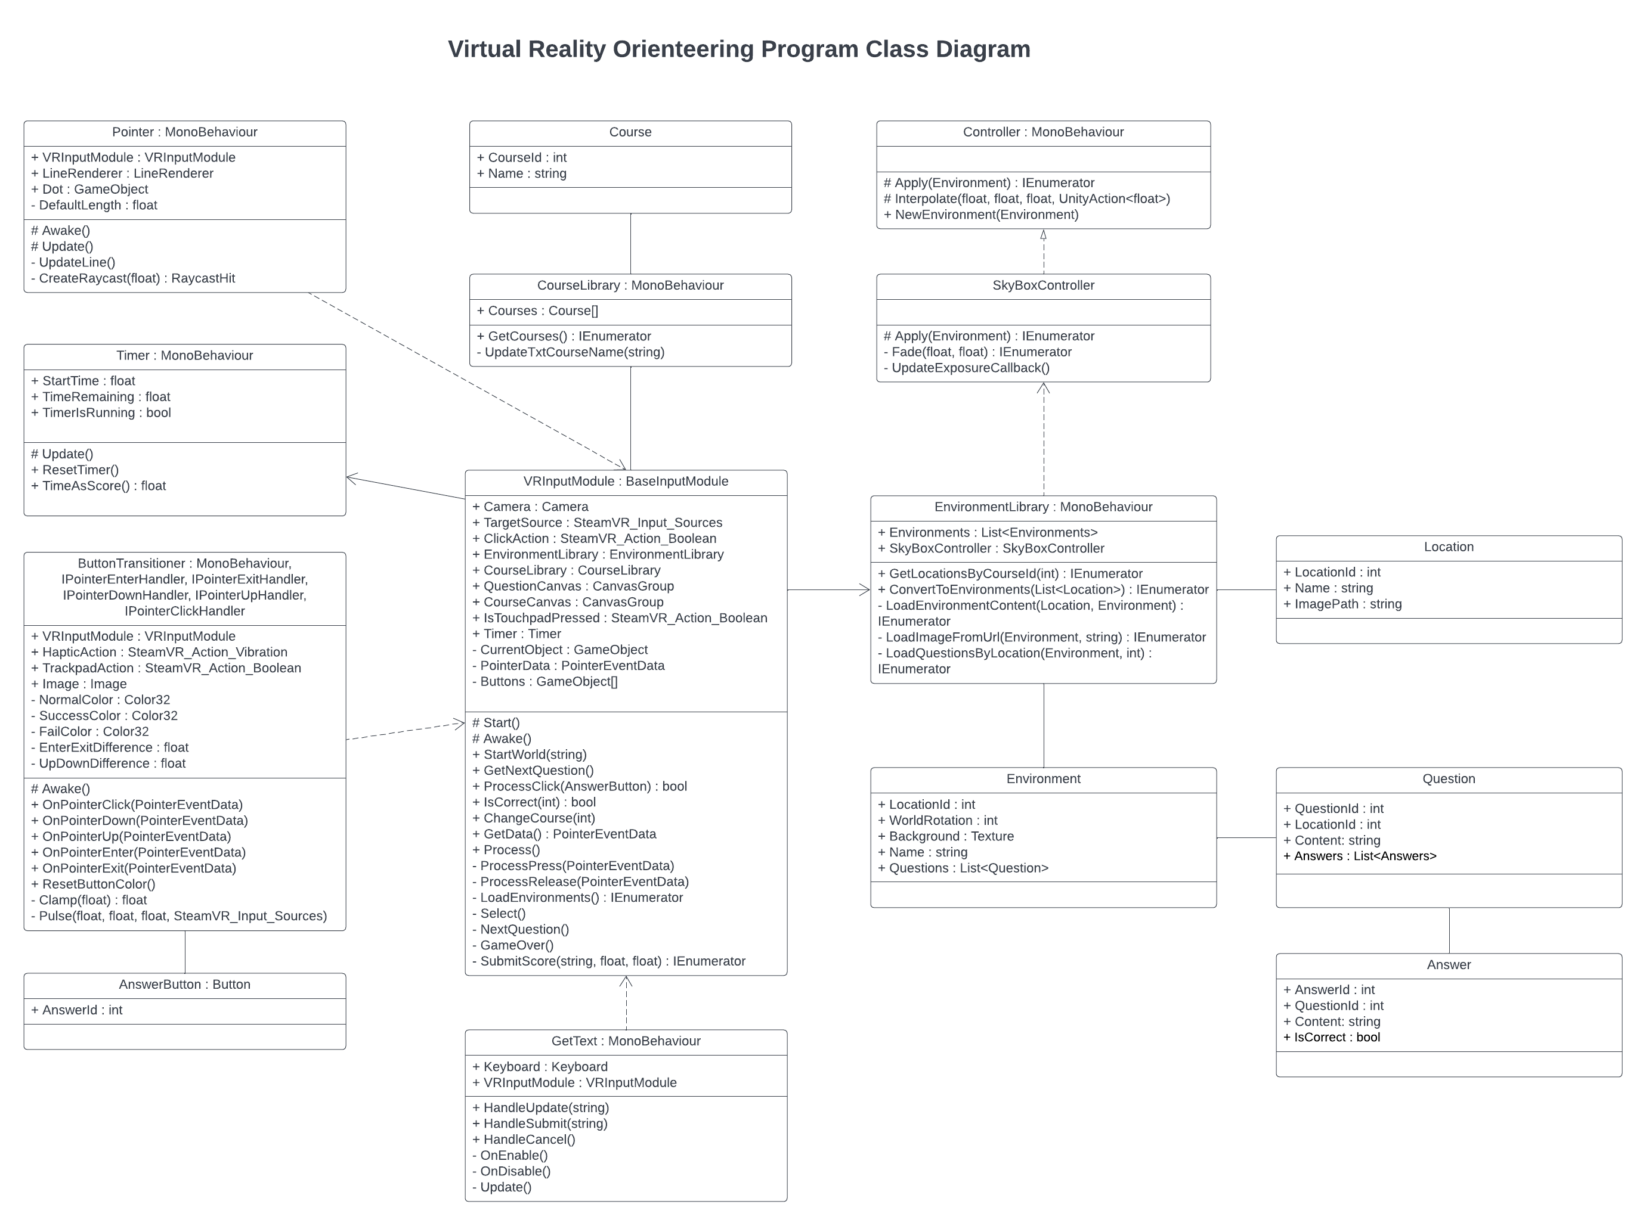
Class Diagram – VR Orienteering

Slide 23
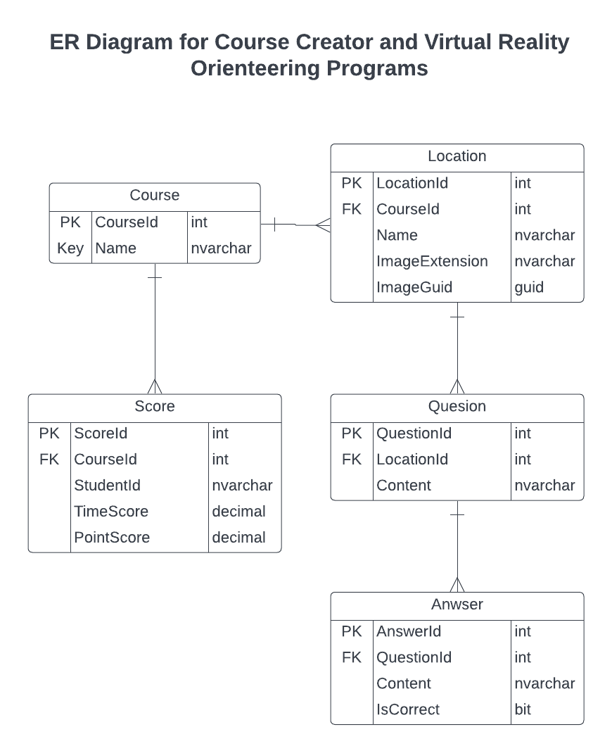
Database
Microsoft SQL Server
Transparent Data Encryption (TDE)
ER Diagram

Slide 24
Communication between Programs
RESTful Web API
Basic Authentication
JSON

Slide 25
Implementation – Course Creator
Authorization

Slide 26
Implementation – Course Creator
Courses
Courses Viewer
Cascade Delete

Slide 27
Implementation – Course Creator
Locations
Location Viewers
Upload 360 Photo

Slide 28
Implementation – Course Creator
Questions
Question Viewer

Slide 29
Implementation – Course Creator
Answers
Answers Viewer

Slide 30
Implementation – Course Creator
Scores
Scores Viewer

Slide 31
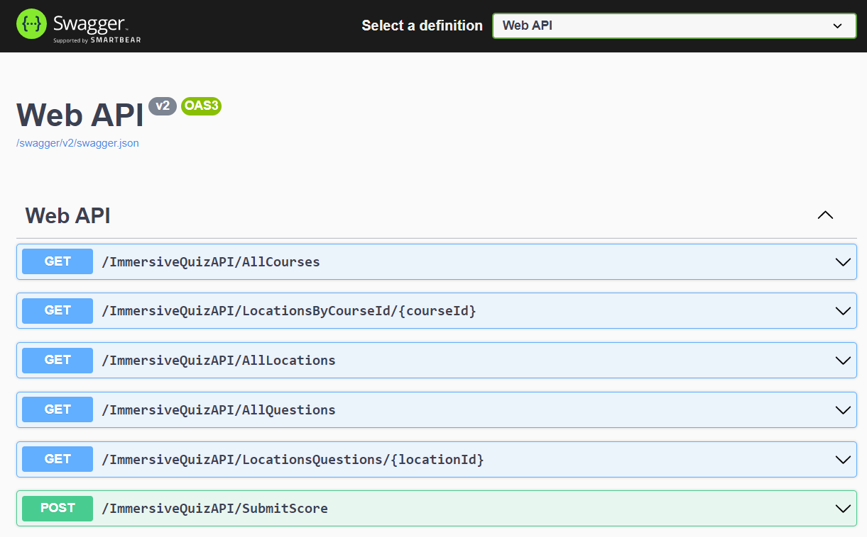
Implementation – Course Creator
Web API
Swagger

Slide 32
Implementation – VR Orienteering
Authorization

Slide 33
Implementation – VR Orienteering
Displaying a Course
Score Keeping
Submitting Score

Slide 34
Testing
Input Validation
Unit Testing
Acceptance Testing
Integration Testing

Slide 35
Challenges
Full-Time Work of Developer
Decreased Project Sponsor Involvement
VR Development

Slide 36
Future Work
Server Hosting
VR Orienteering Modularization
Ease-of-use Features

Slide 37
Questions?

